Slide 1
Networks 102
connecting from home

Slide 2
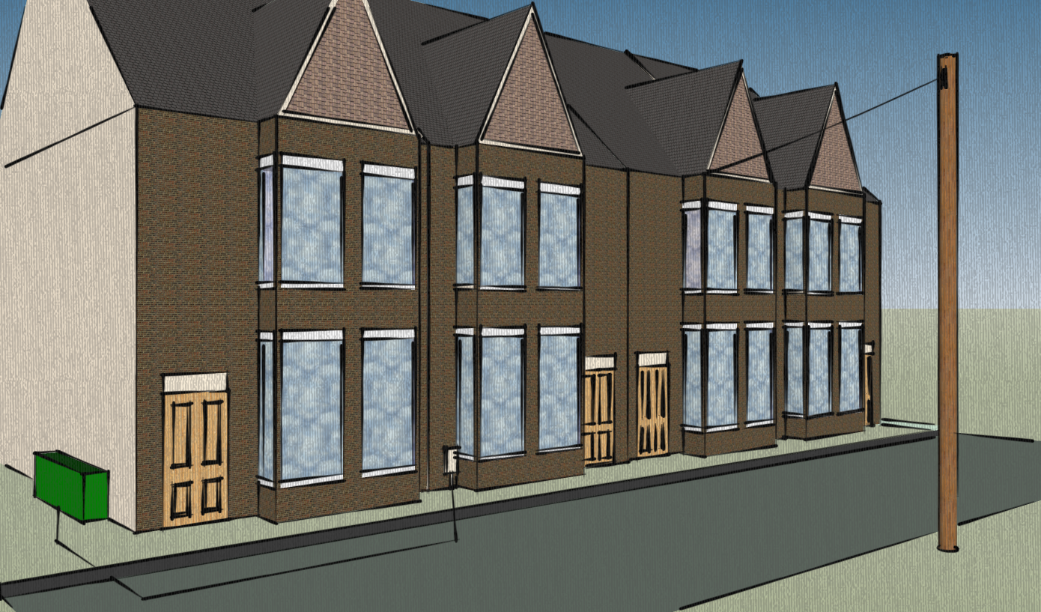
Connecting a house

Slide 3
Connecting a house — DSL
Telephone
wire
Street
cabinet

Slide 4
Connecting a house — Cable
Street
cabinet
Cable
inlet

Slide 5
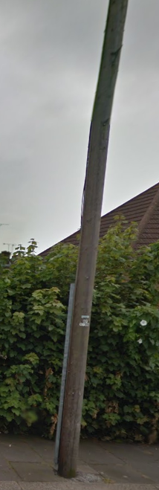
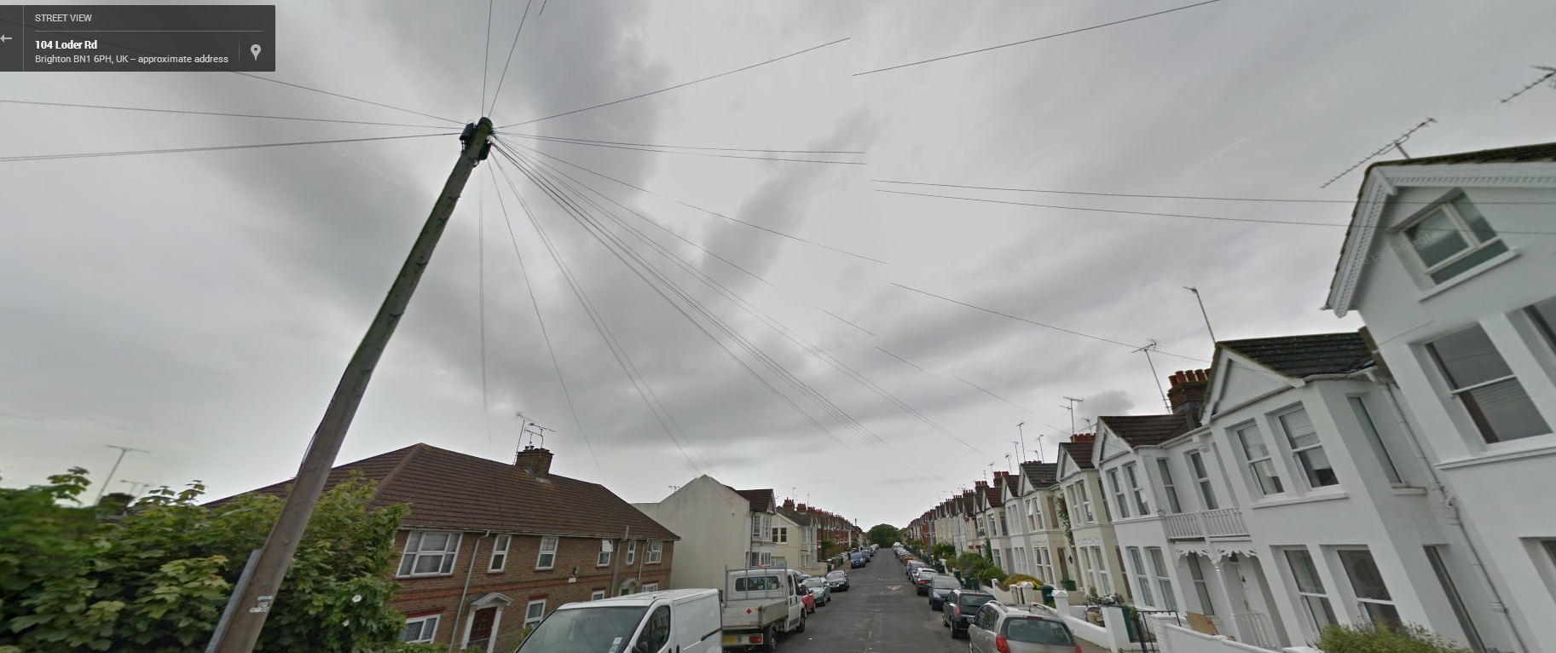
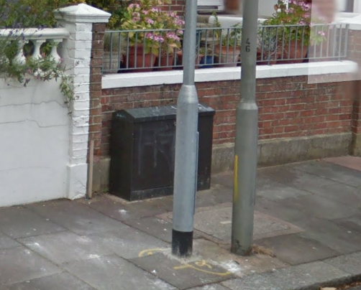
Phone lines in Loder Road
Go into the
pavement
lines to the houses
Google Street View 2014
The cabinet at the end of the road

Slide 6

The Internet Video—press play

Slide 7
Quick fact check—I.P. Address
Everything on the Internet has an I.P. address. I.P. stands for Internet Protocol
It is a unique number that identifies that device, a bit like how your postal address identifies your home
E.g. One of Google’s I.P. addresses is 45.732.34.353
Your Internet Service Provider gives your modem an I.P. address so web-servers can send bits of the web pages back to your home

Slide 8
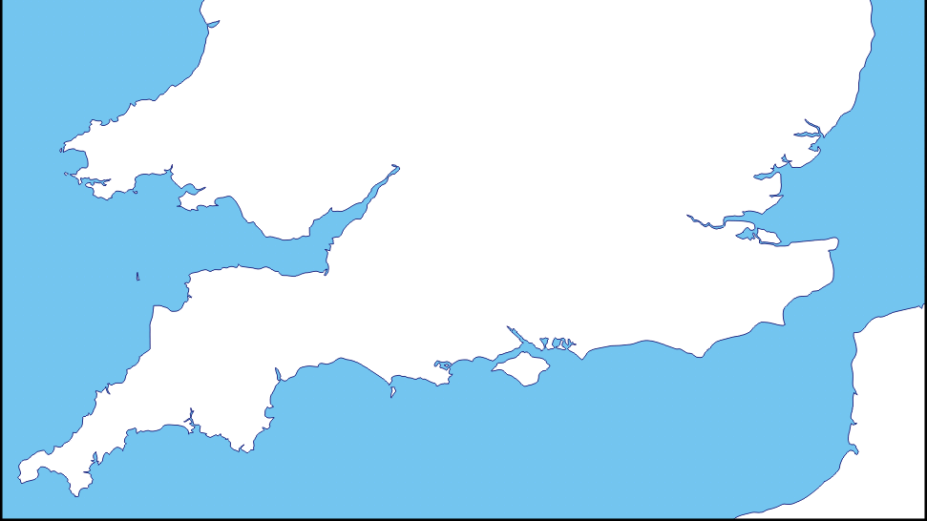
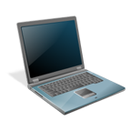
Your home to London then the Atlantic
London
Telehouse
Telehouse routes
You to America
Your ISP connects
you to Telehouse
It also tells your
computer the IP address
Undersea
cable point
Brighton

Slide 9
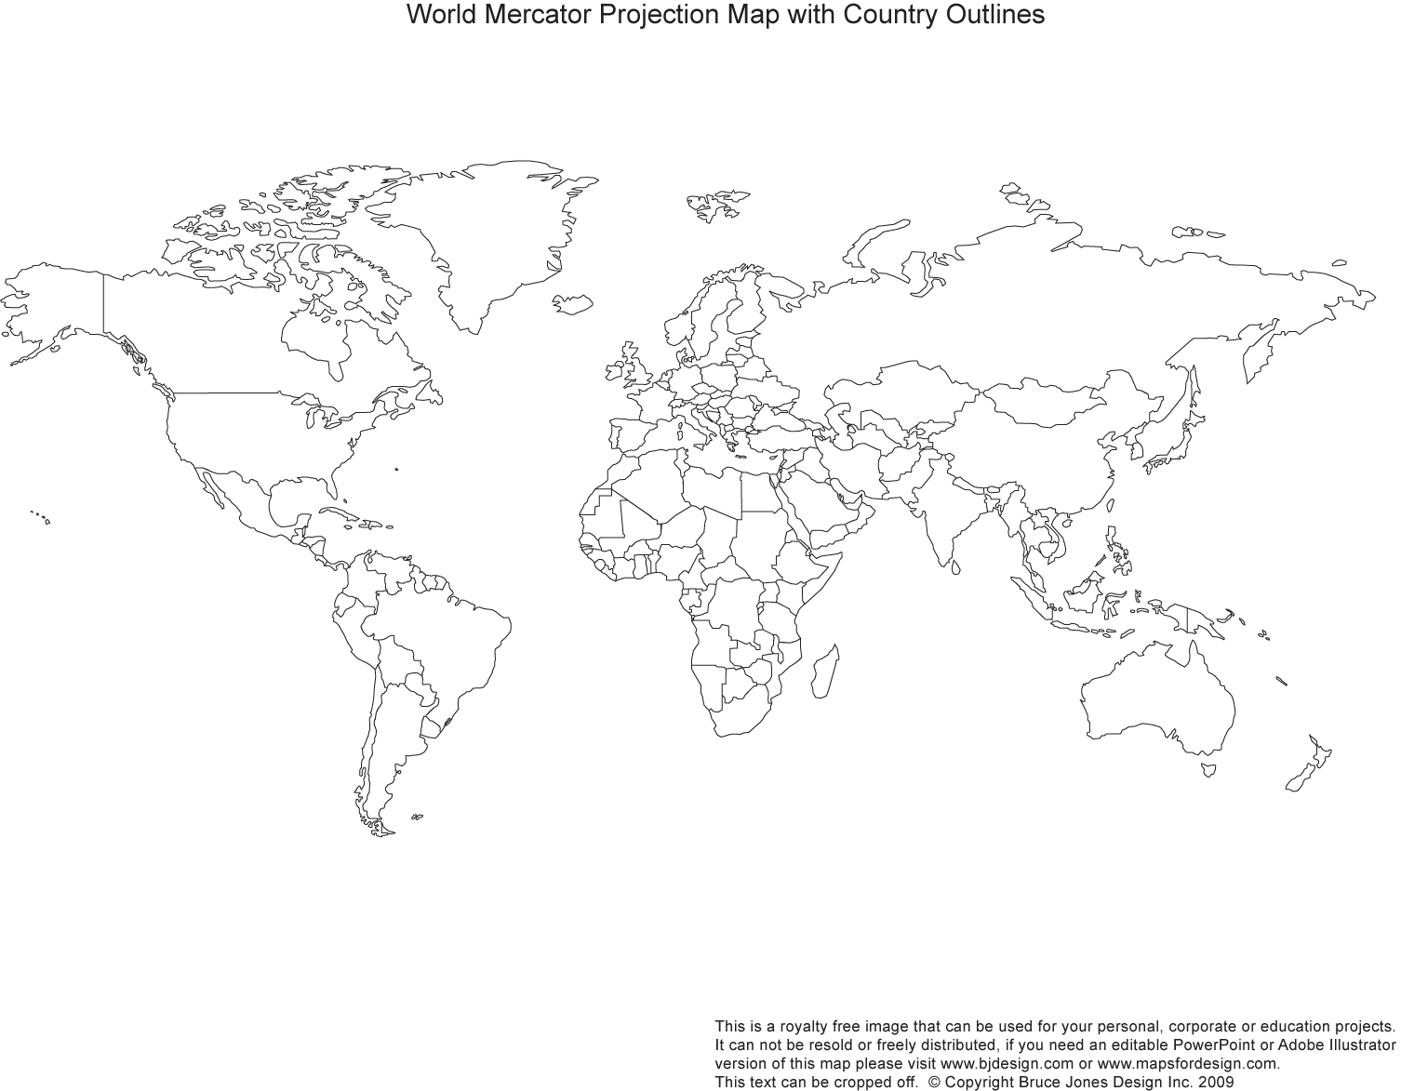
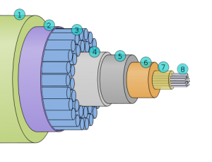
Across the Atlantic
L.A.
60 Husdon St
New York
Undersea cables
7.5 cm thick

Slide 10
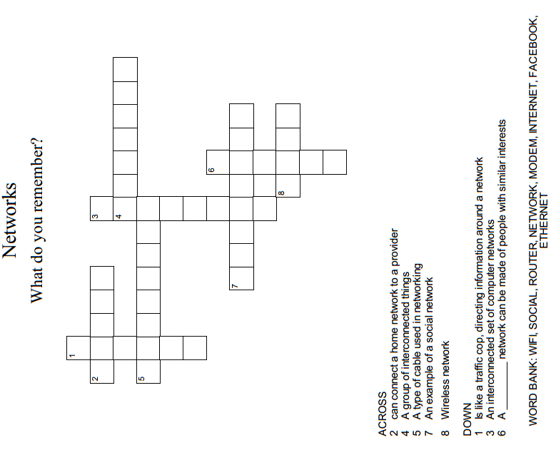
Hand-out 1
Ever-heard-the word?
Look at the sheet in your book from last lesson. Can you add any new definitions or improve some existing ones?

Slide 11
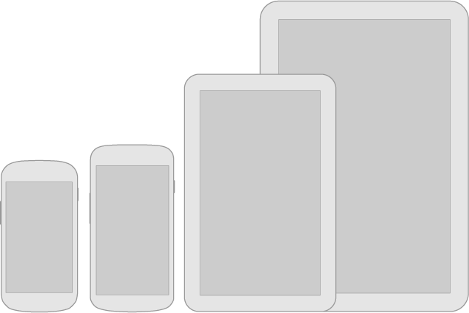

Hand-out 2
From tablet to the internet
network
Put the following in order to describe how a tablet in your home might connect to the internet through cable line.
What needs to happen and in what order for it to work?
Event / thing | Order (1,2,3…) | Why (explain what it does)
A provider (e.g. Virgin Broadband) runs a fibre connection to a street cabinet
When you open a web-browser, your router fetches the information from your provider and sends it on to your tablet
Your modem gets an IP address from your provider
Your tablet is switched on and is connected to the wi-fi
The router is on and providing a wi-fi signal
Your modem is switched on
The router gives your tablet an IP address for your home network
A router is connected to the modem (might be part of the same box!)
Globe image by Peter Mercator, www.wikipedia.org

Slide 12
Hand-out 2
From tablet to the internet
network
Put the following in order to describe how a tablet in your home might connect to the internet through cable line.
What needs to happen and in what order for it to work?
Event / thing | Order (1,2,3…) | Why (explain what it does)
A provider (e.g. Virgin Broadband) runs a fibre connection to a street cabinet | 1 | To connect the street to the internet
Your modem is switched on | 2 | Starting the modem will make it connect to your provider
Your modem gets an IP address from your provider | 3 | This is so the internet data can be sent to your home
A router is connected to the modem (might be part of the same box!) | 4 | This makes sure the network in your house can access the internet
The router is on and providing a wi-fi signal | 5 | The tablet will access your home network wirelessly
Your tablet is switched on and is connected to the wi-fi | 6 | The tablet needs to be able to connect to your network
The router gives your tablet an IP address for your home network | 7 | This lets the router traffic data from the modem to your tablet
When you open a web-browser, your router fetches the information from your provider and sends it on to your tablet | 8 | So you can do whatever it is that you wanted to do
Globe image by Peter Mercator, www.wikipedia.org

